Slide 1
Learning Explainable Navigation Cues via Dual-Head Deep Learning
Explainable Vision-Based Navigation on Lane-less Roads
Presenters:
SHACHAR LEVI
GUY YOGEV

Slide 2

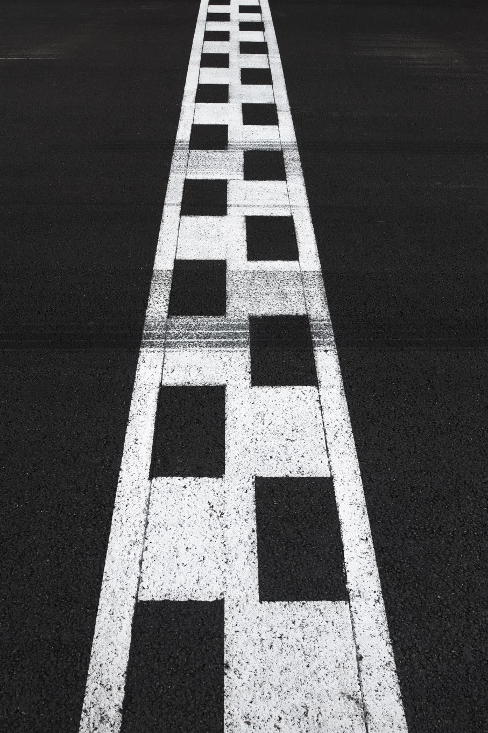

Problem Statement
Autonomous driving systems often assume clear lane markings and structured roads.
In many real-world scenarios, lanes are missing, faded, or completely unreliable.
Classical semantic segmentation only identifies where the road is, but does not provide a driving decision.
End-to-end steering models predict actions directly, but operate as a black box with no visual explanation.

Slide 3

Our Innovation (Approach)
Solution: Combining Deep Learning vision with geometric Vector Fields.
Concept: The model does not only segment the road—it learns to predict a Flow vector field that guides the vehicle toward the safe lane center.
Advantages: Increased smoothness, robustness to noise, and improved explainability.

Slide 4
Dataset Choice: IDD
We use the India Driving Dataset (IDD), which represents highly unstructured road environments.
Scenes include missing lane markings, dense traffic, pedestrians, shadows, and irregular road boundaries.
This dataset forces spatial reasoning instead of relying on lane-following heuristics.

Slide 5

Raw Data Representation
Original annotations are provided as JSON files containing polygonal regions.
Polygons describe road, parking, drivable fallback areas, and other objects.
Such representations are not directly usable for convolutional neural networks.

Slide 6
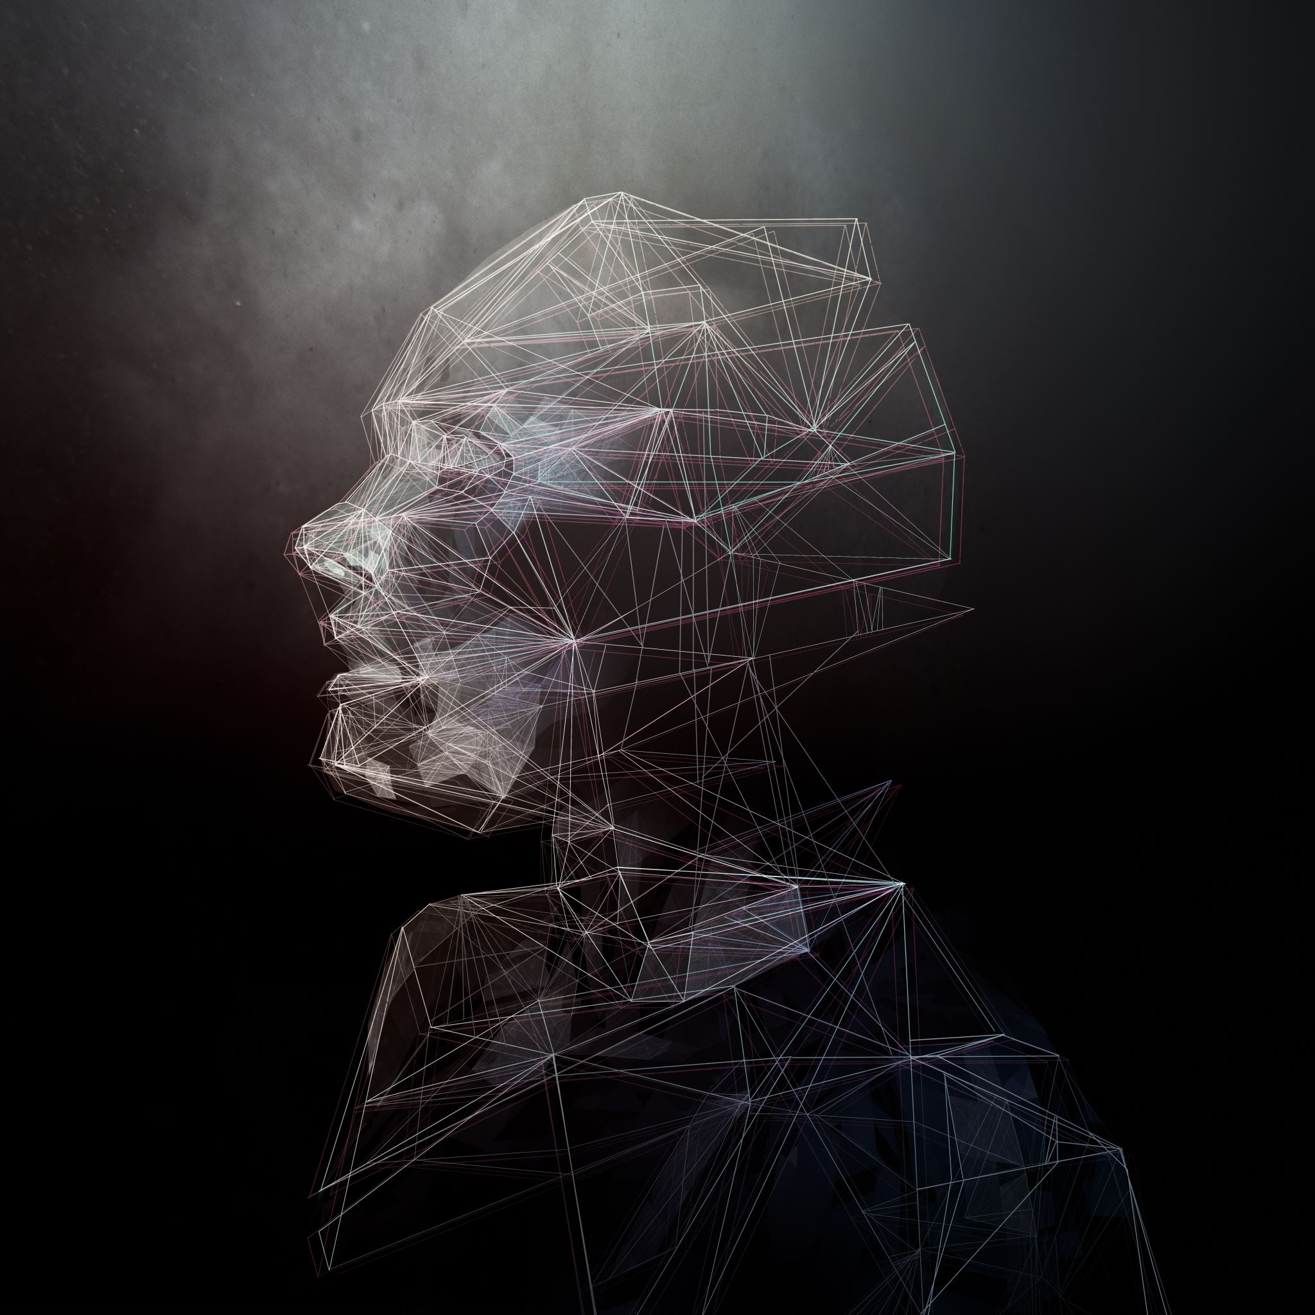
Polygon to Mask Conversion
Polygons are rasterized into pixel-wise masks in image space.
All non-drivable objects (vehicles, pedestrians) are preserved as obstacles.
This ensures that obstacles explicitly remove drivable regions from the road mask.

Slide 7

Ground Truth for Navigation
From the drivable mask, we compute a continuous safety representation.
Distance Transform assigns higher values to pixels farther from obstacles and borders.
Spatial gradients of this map define a vector field pointing toward safer regions.

Slide 8
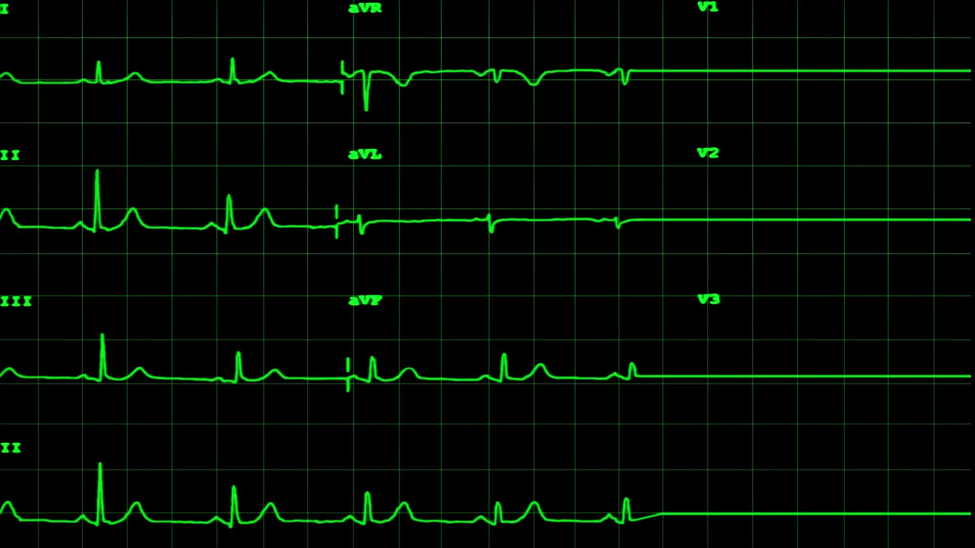
Algorithm 1: Ground Truth Flow Construction
Input:
Drivable area mask M (binary)
Steps:
1. BinaryRoad extract drivable pixels from M
2. DistMap DistanceTransform(BinaryRoad)
3. GradX, GradY ∇DistMap
4. Flow Normalize([GradX, GradY])
Output:
Safety Potential Map (DistMap)
Flow Field (Flow)
Notes:
This algorithm converts geometric distance information into a navigational signal. The gradient of the distance map naturally points toward safer, more central regions.

Slide 9
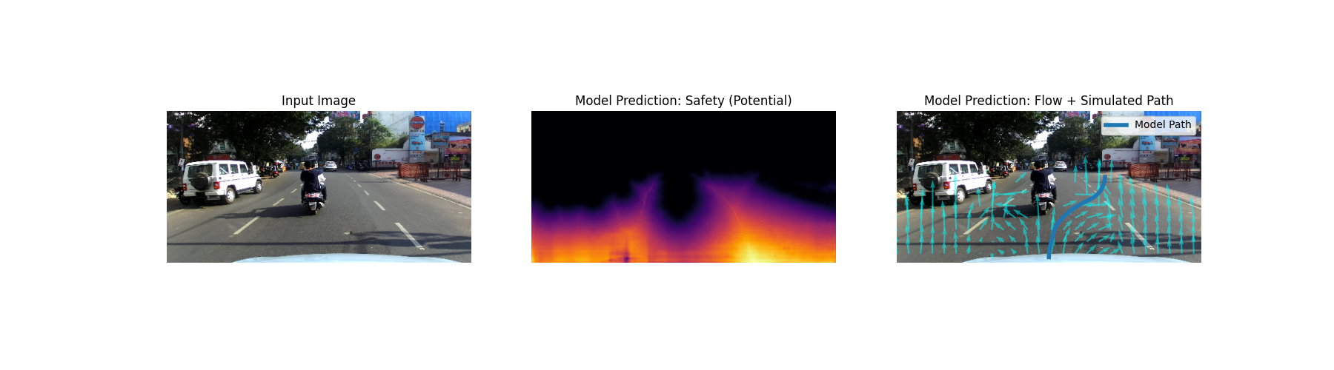
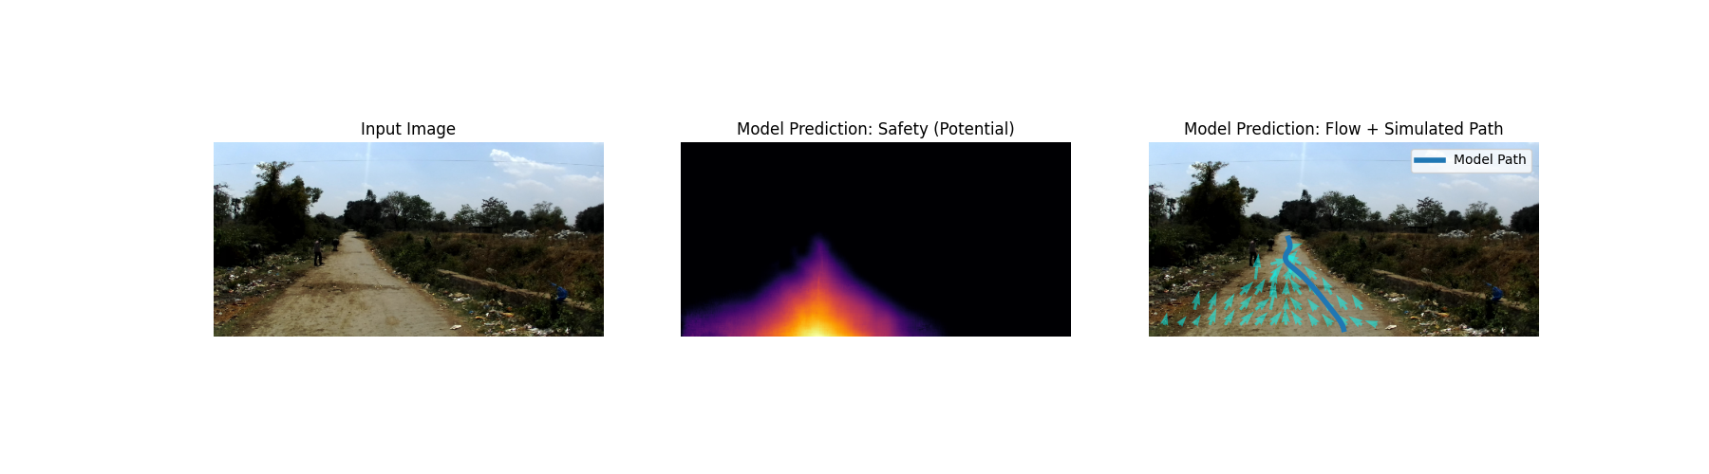
Preprocessing Visualizations
From left to right:
raw image
drivable mask after polygon rasterization
and the resulting potential map used to derive the flow field.

Slide 10
Proposed Model- Dual-Head ResNet50 Model
Backbone: ResNet50 for fine visual feature extraction.
Structure: Shared encoder → split decoder with two heads.
Head 1 – Segmentation:
- Output: 1 channel (scalar probability).
- Meaning: Road vs non-road probability.
Head 2 – Flow:
- Output: 2 channels (X and Y).
- Value range: [-1, 1] via Tanh.
- Meaning: Directional vector toward safer region.
Speaker notes: Each pixel outputs an arrow telling us which way to move for smoother navigation.

Slide 11
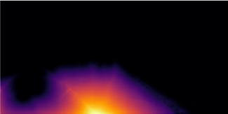
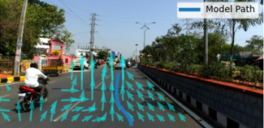
Algorithm 2: Dual-Head Forward Pass
Input:
RGB image
Steps:
1. Extract visual features using Encoder (ResNet)
2. Decode features to a shared spatial representation
3. Predict a safety potential map
(how safe each pixel is)
4. Predict a flow field
(direction of movement toward safer areas)
Output:
Safety potential map
Navigation flow vectors
Notes:
Both outputs are derived from the same visual features. The potential captures *where it is safe*, while the flow captures *how to move locally*.

Slide 12
Training Setup
The potential head is trained using Binary Cross-Entropy loss.
The flow head is trained using Mean Squared Error on vector components.
Joint optimization aligns visual perception with navigational intent.

Slide 13

Smart Augmentations
Goal: Prevent overfitting and improve generalization.
Types of augmentations:
lighting shifts,
motion blur,
mild rotations (±5°).
Horizontal flips.

Slide 14
Baselines – Competitors
To validate, we compared against two controlled baselines:
1. U‑Net Classic: standard segmentation model.
2. Single-Head ResNet50: same backbone without Flow head.
Goal: Isolate contribution of Flow head and prove improvement is architectural, not computational.

Slide 15
Quantitative Comparison
Model | IoU | RMSE (px) | Smoothness
FlowNav (Ours) | 0.829 | 3.33 | 0.127
Classic U-Net | 0.685 | 39.14 | 2.129
ResNet50-Single | 0.831 | 43.02 | 1.210

Slide 16
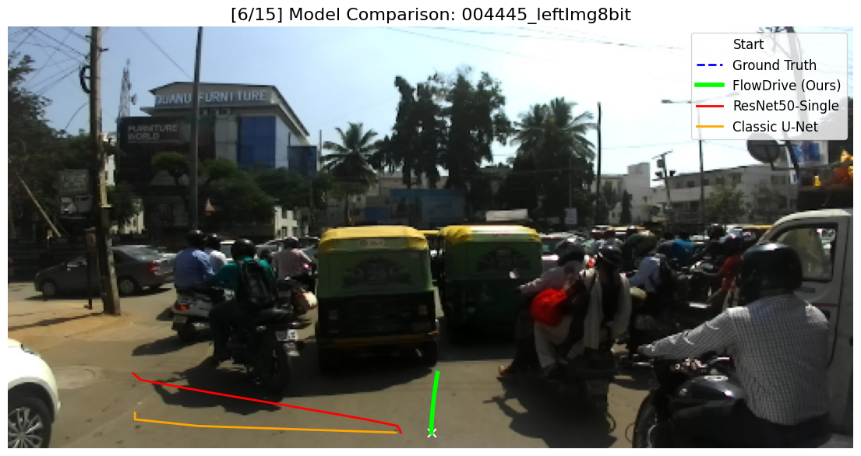
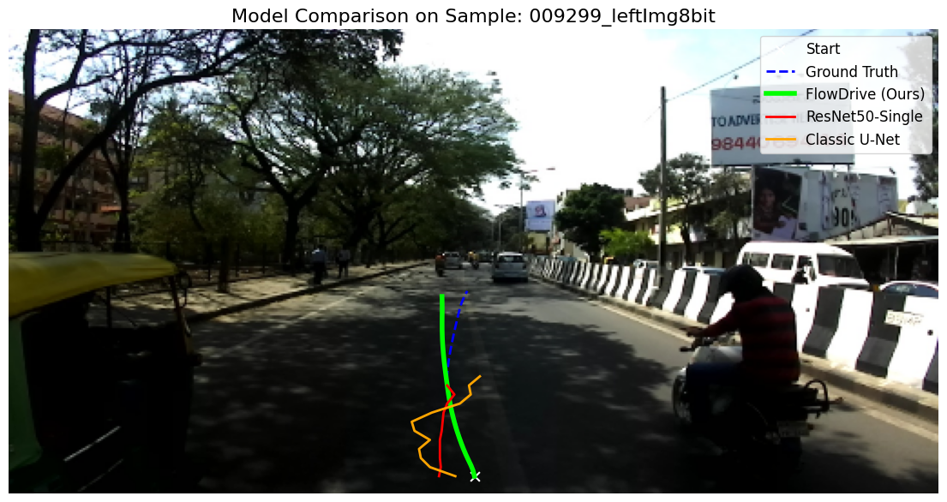
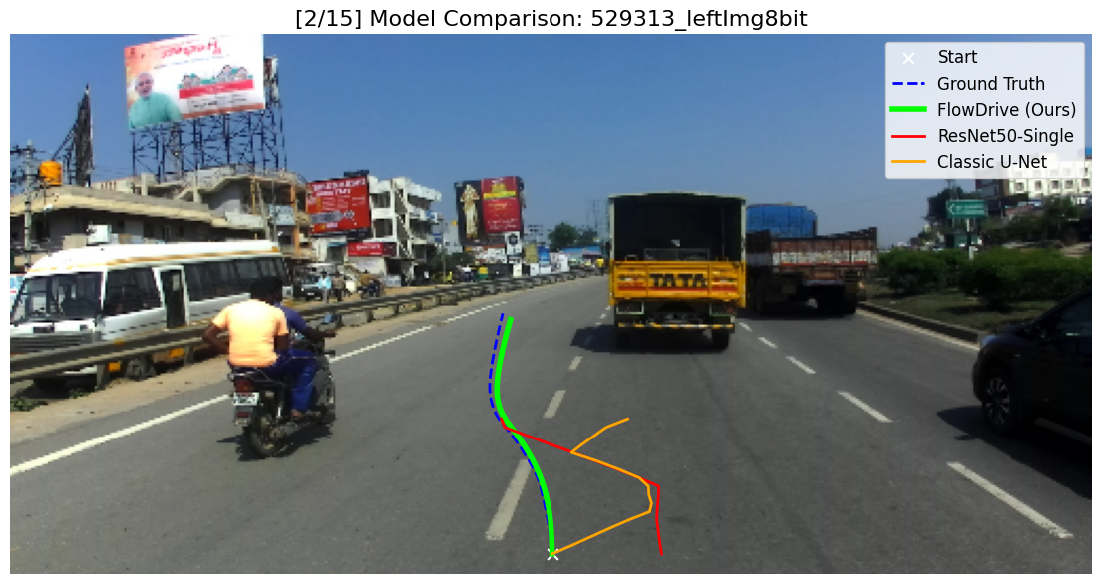
Qualitative Comparison: All Models
FlowNav produces smoother and more centered trajectories compared to single-head baselines,
especially in noisy or ambiguous scenes.

Slide 17
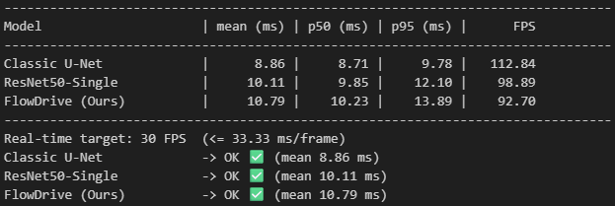
Runtime Performance
All evaluated models operate in real-time on GPU.
The proposed dual-head model consistently exceeds 30 FPS.
The flow head introduces only minor computational overhead.

Slide 18
Conclusions
Learning a flow field provides actionable navigation cues beyond segmentation.
The dual-head formulation improves path stability and accuracy.
The approach is interpretable, robust, and suitable for real-time deployment.

Slide 19
Future Work
Integration with a closed-loop vehicle controller or simulator (e.g., CARLA).
Temporal consistency using video-based models.
add BDD dataset for weather + environment diversity.

Slide 20
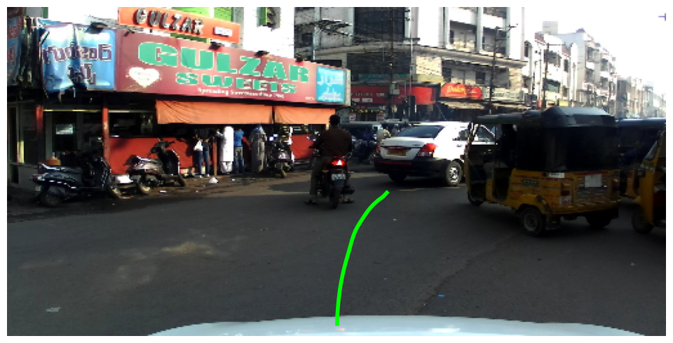
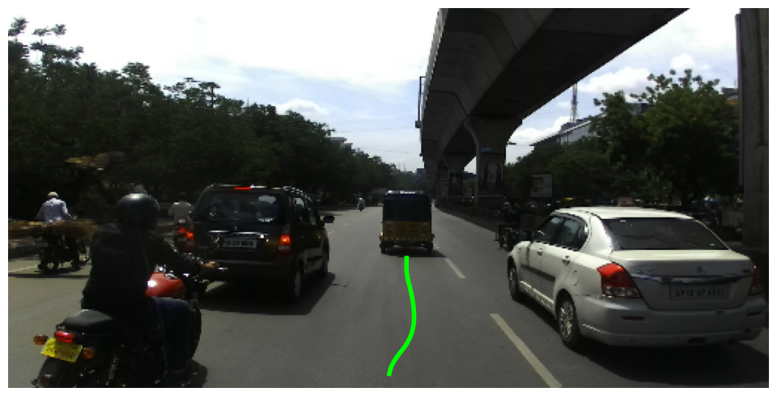
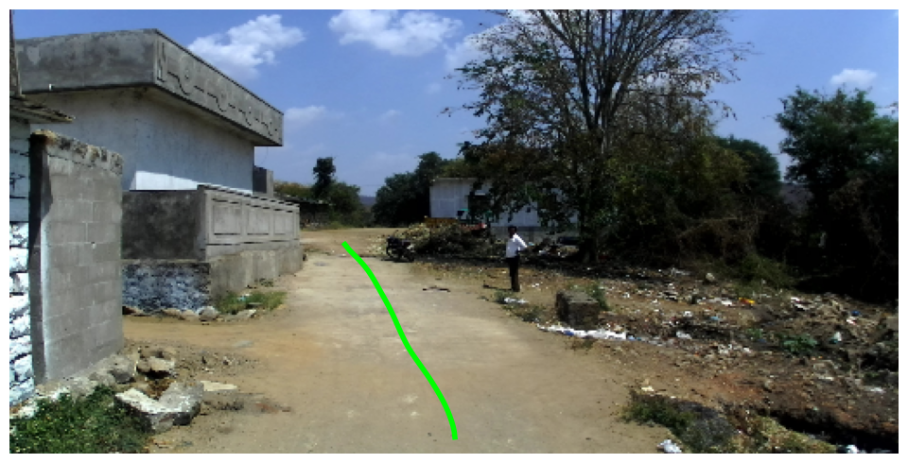
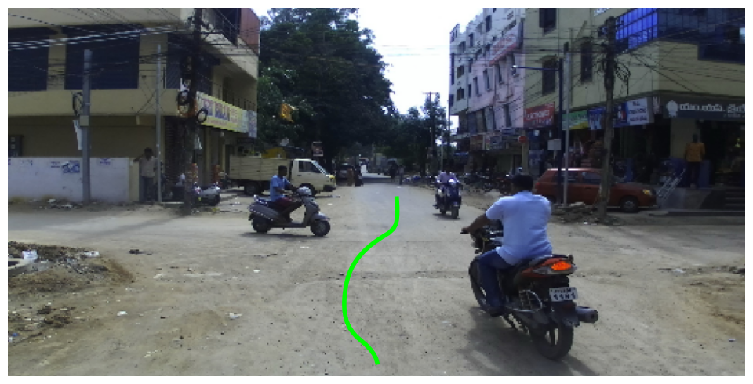
Thank you! Questions?

